Slide 1
FAKE SEED DETECTOR
Real-time identification of counterfit seeds using Computer vision.
Team: ZeroToOne
Team member: P.Poojith Kumar

Slide 2
Problem:
Fake seeds are sold as genuine using dyes and coatings
Farmers suffer crop loss, debt, and loss of livelihood
Challenges:
Traditional verification (DNA, spectroscopy) is expensive
Not feasible for rural or local markets
Goal:
Build a low-cost, image-based AI system
Runs on standard devices
Gives instant authenticity decision

Slide 3
Our Solution:
A computer vision–based seed authenticity verifier
Uses seed surface, color, and texture features
Deployed as a real-time Streamlit web app
Input: Seed image
Output:
Prediction:
Genuine /
Fake
Confidence score

Slide 4
Dataset:
Crop: Pea seeds
Total images: 5513
Genuine seed images: 1200
Spoiled / fake seed images: 4311
Images used for:
Training
Validation
Dataset used as-is for model training

Slide 5
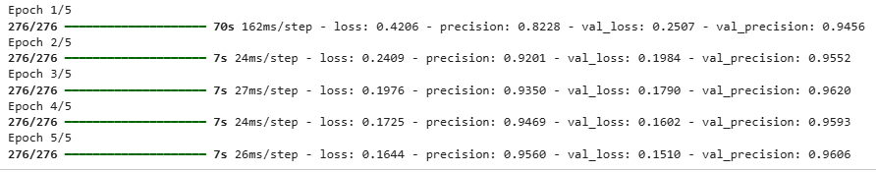
Model:
EfficientNet (pretrained on ImageNet)
Lightweight and fast
Pipeline:
Image upload
Preprocessing & normalization
Feature extraction
Binary classification
Precision-focused decision

Slide 6
Metrics Used:
Precision (priority over accuracy)
Validation precision ≈ 95–96%
Inference time < 2 seconds
Why Precision Matters:
A fake seed marked as genuine causes total crop loss
We intentionally used a higher decision threshold

Slide 7
Deployment:
Trained in Google Colab
Deployed using Streamlit
Features:
Simple UI for non-technical users
Image upload
Instant prediction + confidence
Scalability:
Can be retrained for other crops
Mobile-friendly and low-cost

Slide 8
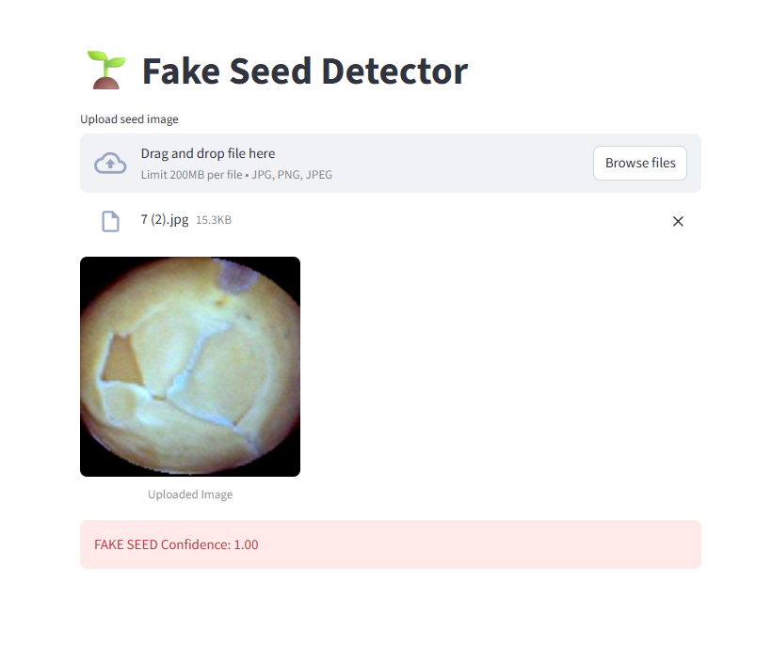
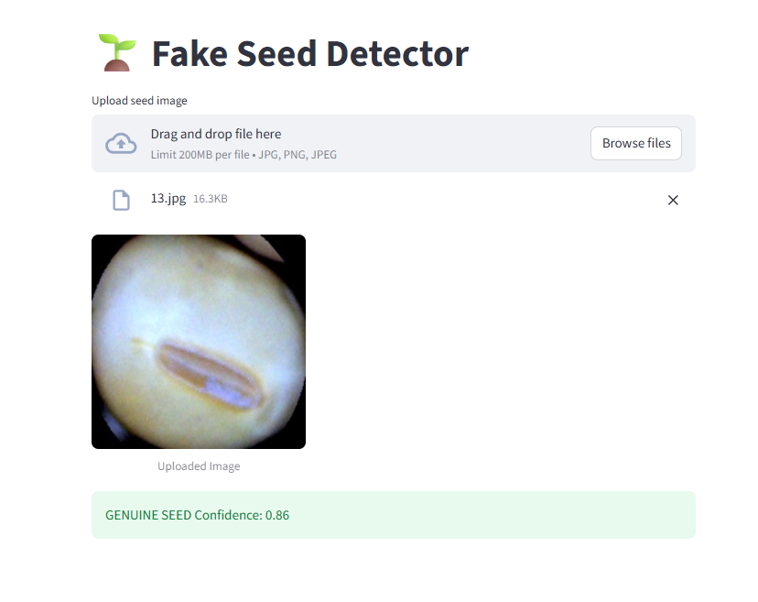
RESULTS

Slide 9
Thank you

